Slide 1


MINOR PROJECT-I BATCH – 47 Blutooth based Home Automation using Arduino
By
Pavithran A V [21BEC145]
Praveen S [21BEC151]
Priyakanth K [21BEC156]
Sabari J [21BEC168]
GUIDE
Dr. D. JAYASEELAN

Slide 2

List of Content
Abstract
Introduction
Proposed Method
APP Devoloping & ARDUINO Coading
Components Required , Budget, Features
Work Progress
References

Slide 3
Abstract
Smart Home is a house that uses information technology to monitor the enviroment, control the electric appliance and communicates with the outer world
Smart Home is a complex technology, at the same time it is developing.
The system is based on the embedded systerm and can act as a security guard of the home

Slide 4
Introduction
There is an increasing demand for smart homes, where appliances react automatically to changing environmental conditions and can be easily controlled device.
These project presents a possible solution where by the user controles devices by using there existing mobile phone , where control is communicated to the Microcontroller from a mobile phone through it is Blutooth interface.
The Home automation system used an android application and a Blutooth technology in the design, this is because they are easy to use, fast, readily available, and reliable in communications between the remote user and devices.

Slide 5
COMPONENTS DETIALS
COMPONENTS
Arduino Uno
Powersupply
Bread Board
Blutooth Module
Load (Bulb 220V)
Relay Module
Jumper Wires
Smart Phone (Blutooth Enabled)
S. No. | Components | Amount
1. | Arduino Board | Rs.500
2. | Relay Module | Rs.200
3. | Blutooth Module | Rs.500
5. | Others | Rs.500
6. | Total | Rs.1800

Slide 6
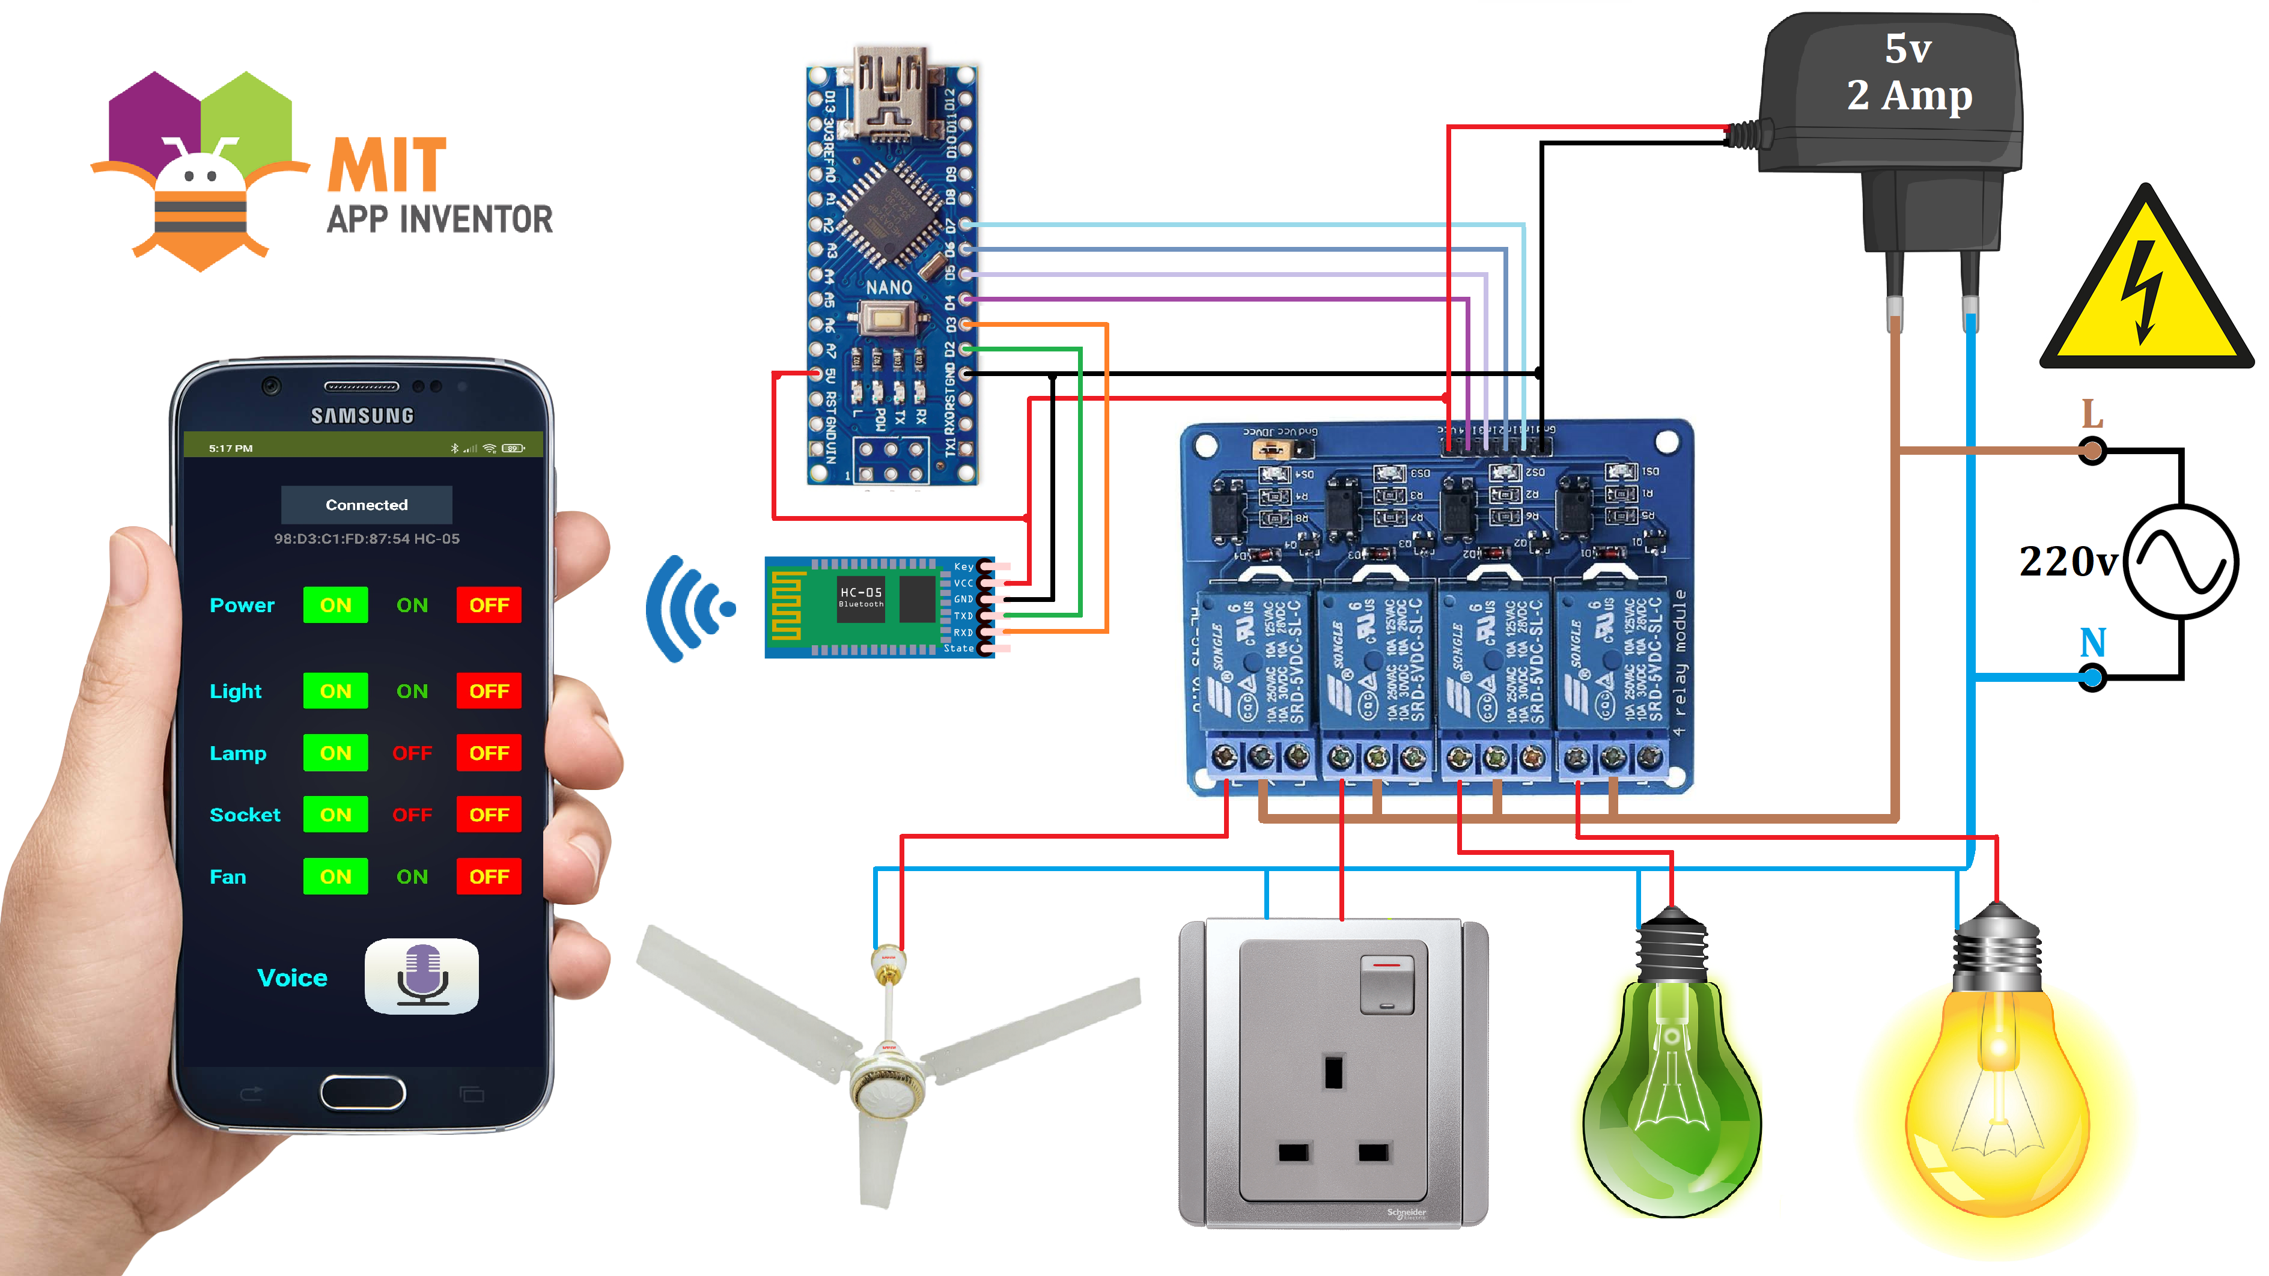
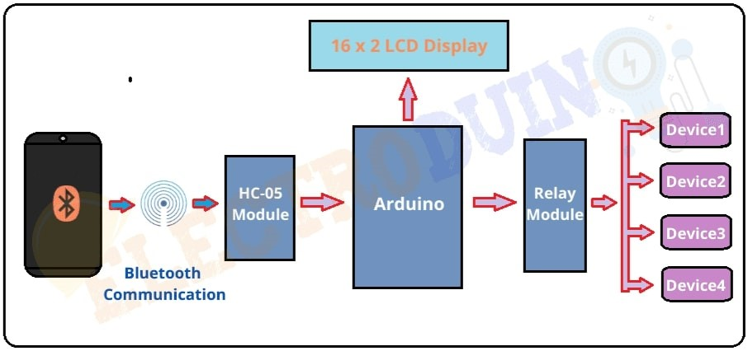
Proposed Method
The design of proposed
method is based on
Arduino Board, Relay
Module, and Smart
Apllication

Slide 7
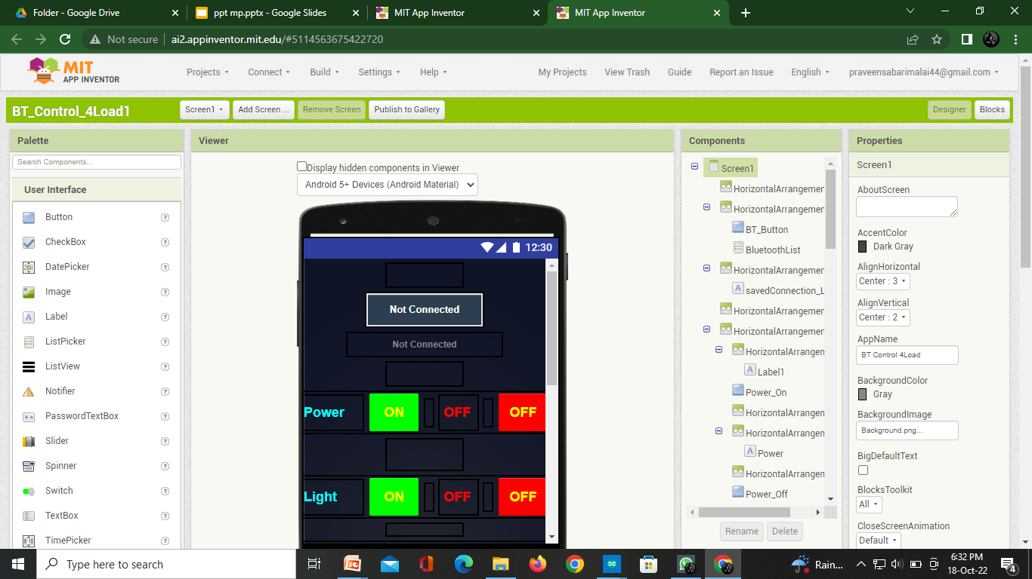
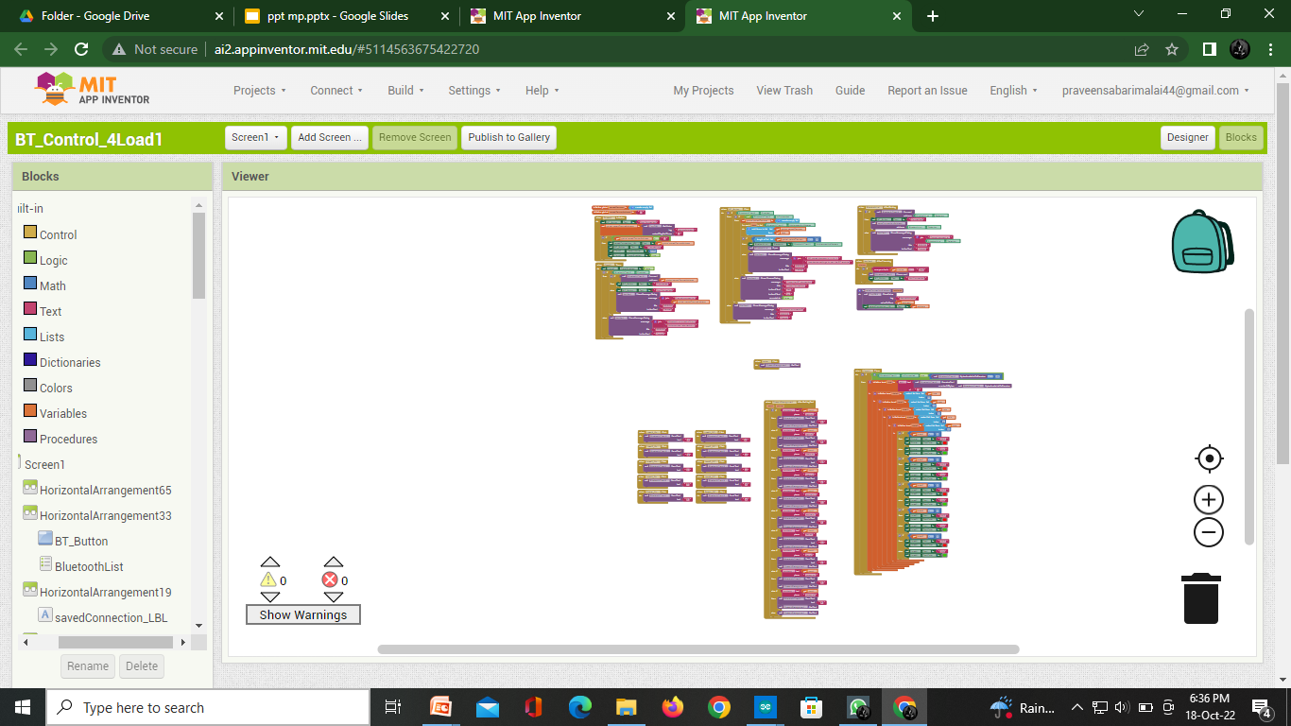
MOBILE APPLICATION
Mobile Application will be developed with help of MIT APP INVENTOR link:- https://appinventor.mit.edu/
INTERFACE DESIGN
CODE BLOCK

Slide 8
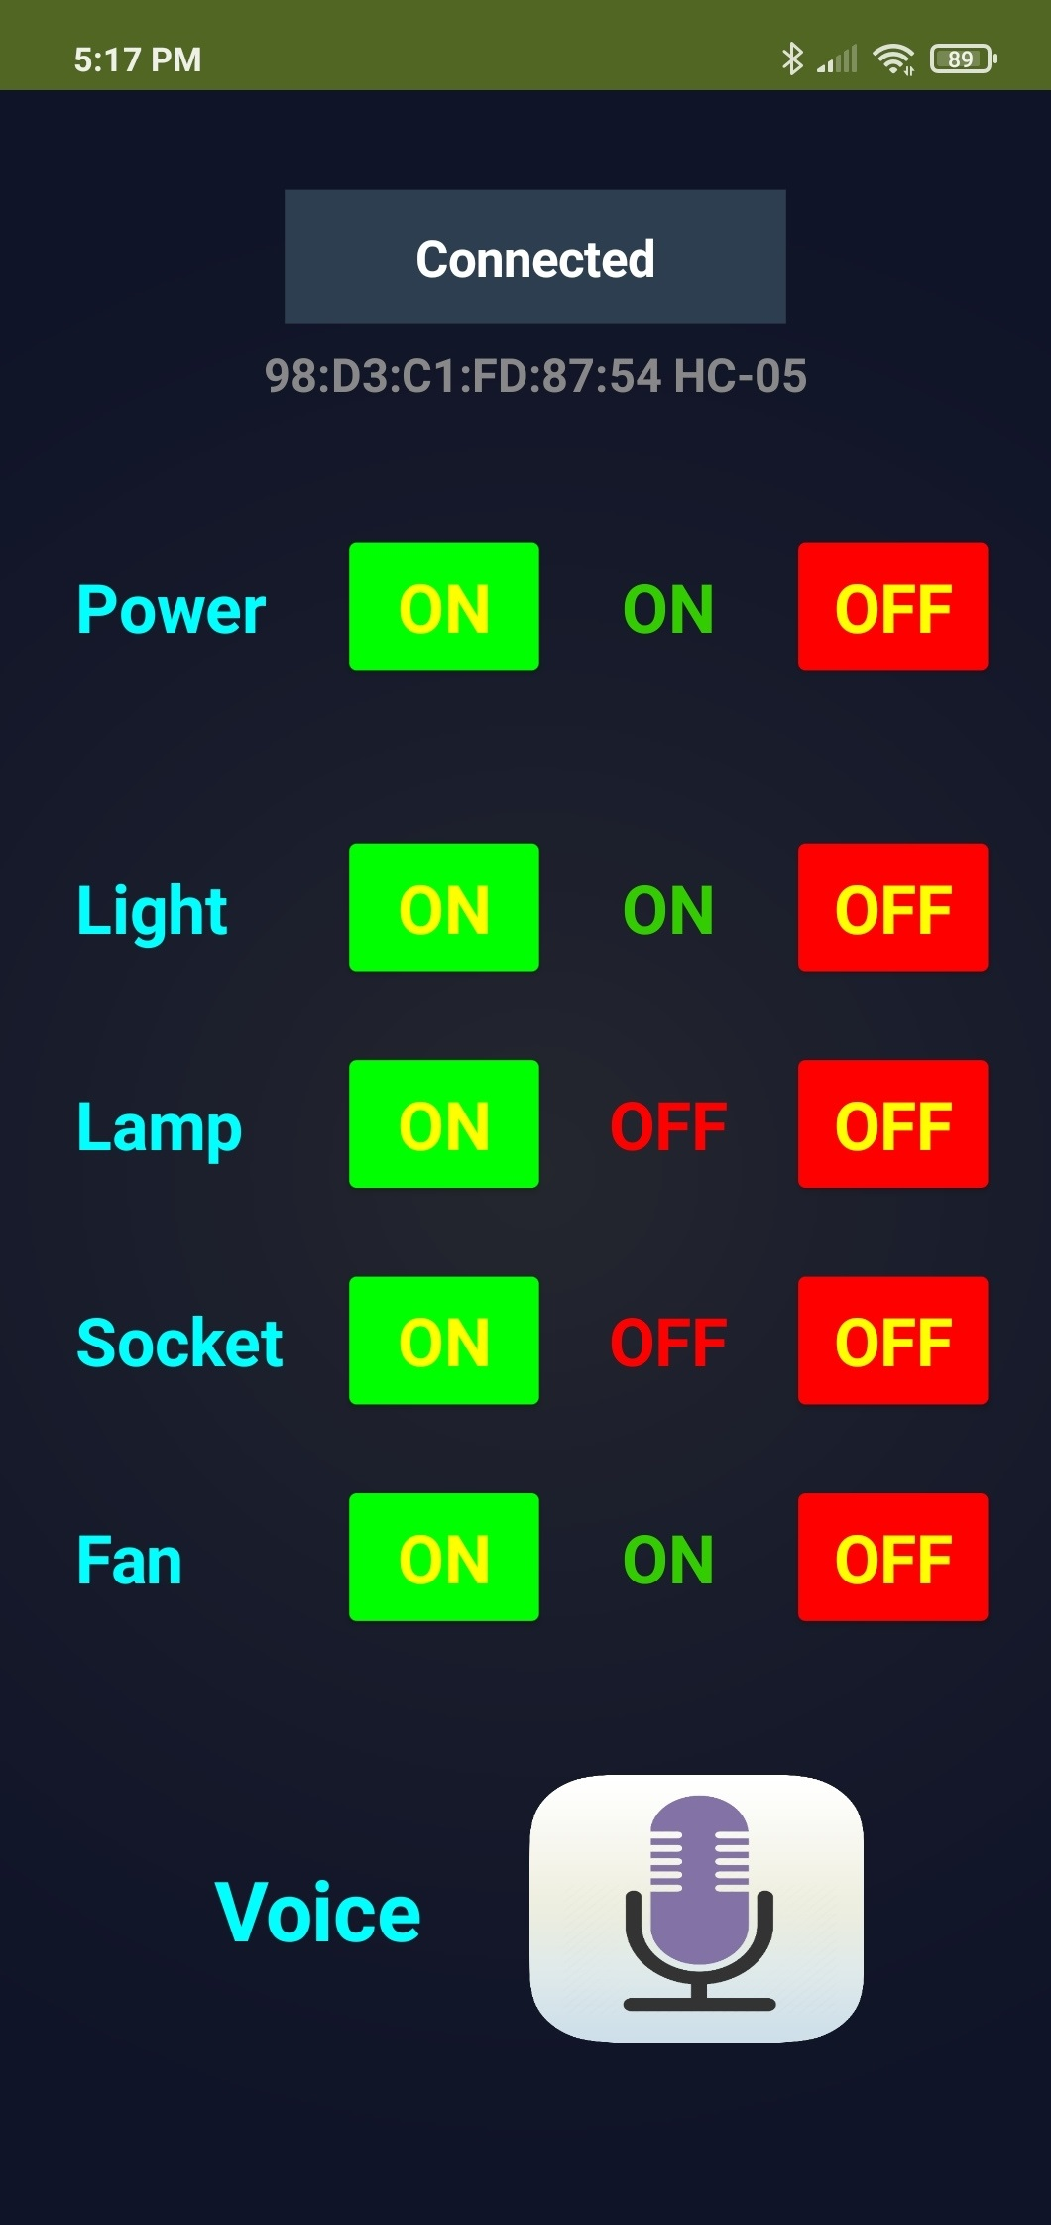
MOBILE APPLICATION
Final Outcome of the Application

Slide 9
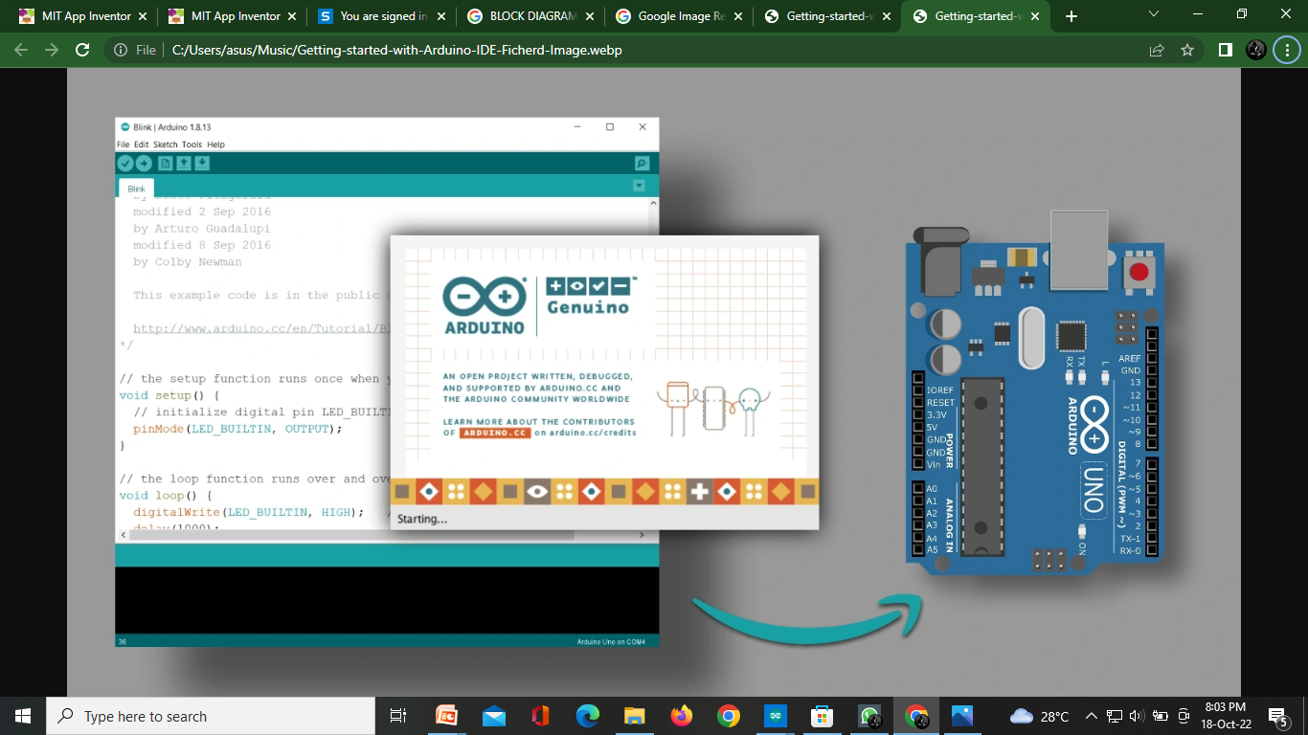
ARDUINO CODING
Arduino coding will be write with the help of ARDUINO IDE
OUR ARDUINO CODE WILL BE CONSIST OF 75 LINES AND SUCCESFULLY EXECUTED
OUR CODE WILL DISPLAYED BELOW

Slide 10

#include <EEPROM.h>
#include <SoftwareSerial.h>
SoftwareSerial BT_Serial(2, 3); // RX, TX
#define Relay1 4 // Load1 Pin Out
#define Relay2 5 // Load2 Pin Out
#define Relay3 6 // Load3 Pin Out
#define Relay4 7 // Load4 Pin Out
char bt_data; // variable to receive data from the serial port
int load1, load2, load3, load4, power;
void setup(){
Serial.begin(9600);
BT_Serial.begin(9600);
pinMode(Relay1, OUTPUT); digitalWrite(Relay1, 1);
pinMode(Relay2, OUTPUT); digitalWrite(Relay2, 1);
pinMode(Relay3, OUTPUT); digitalWrite(Relay3, 1);
pinMode(Relay4, OUTPUT); digitalWrite(Relay4, 1);

Slide 11
load1 = EEPROM.read(1);
load2 = EEPROM.read(2);
load3 = EEPROM.read(3);
load4 = EEPROM.read(4);
power = EEPROM.read(5);
delay(500);
}
void loop() {
if(BT_Serial.available()>0){bt_data = BT_Serial.read();}
if(bt_data == 'A'){load1=0;EEPROM.write(1, load1);}
if(bt_data == 'a'){load1=1;EEPROM.write(1, load1);}
if(bt_data == 'B'){load2=0;EEPROM.write(2, load2);}
if(bt_data == 'b'){load2=1;EEPROM.write(2, load2);}
if(bt_data == 'C'){load3=0;EEPROM.write(3, load3);}
if(bt_data == 'c'){load3=1;EEPROM.write(3, load3);}
if(bt_data == 'D'){load4=0;EEPROM.write(4, load4);}
if(bt_data == 'd'){load4=1;EEPROM.write(4, load4);}
if(bt_data == 'E'){power=0;EEPROM.write(5, power);}
if(bt_data == 'e'){power=1;EEPROM.write(5, power);}

Slide 12
bt_data = '0';
if(power==1){
digitalWrite(Relay1, 1);
digitalWrite(Relay2, 1);
digitalWrite(Relay3, 1);
digitalWrite(Relay4, 1);
}else{
digitalWrite(Relay1, load1);
digitalWrite(Relay2, load2);
digitalWrite(Relay3, load3);
digitalWrite(Relay4, load4);
}
BT_Serial.print(power); //send distance to MIT App
BT_Serial.print(";");
BT_Serial.print(load1); //send distance to MIT App
BT_Serial.print(";");
BT_Serial.print(load2); //send distance to MIT App
BT_Serial.print(";");
BT_Serial.print(load3); //send distance to MIT App
BT_Serial.print(";");
BT_Serial.print(load4); //send distance to MIT App
BT_Serial.println(";");
delay(500);
}

Slide 13
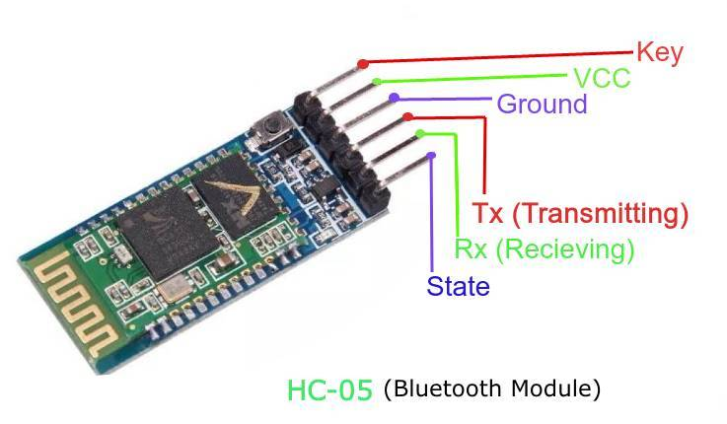
BLUTOOTH MODULE HC-05
The standard feature for cellular phones is a Bluetooth technology which can be used in wireless connection for cellular phones and home appliances. Bluetooth technology gives an efficient method for controlling home automation. It is a low cost and a secured technology. The Arduino Bluetooth board is used in the system. The cell phone is used python program to supply the user interface. The band frequency of working is over 2.4 GHz ISM with a range of 10 m and 1 Mbps speed . This module HC-05 provides a good wireless transmission & a well receiving serial data; it can be used to provide a connection between MCU and PC for the data transferring purpose

Slide 14
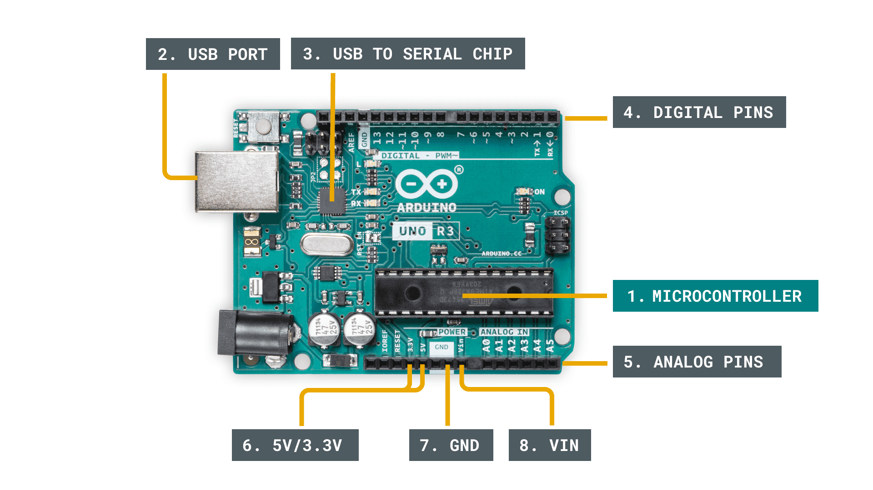
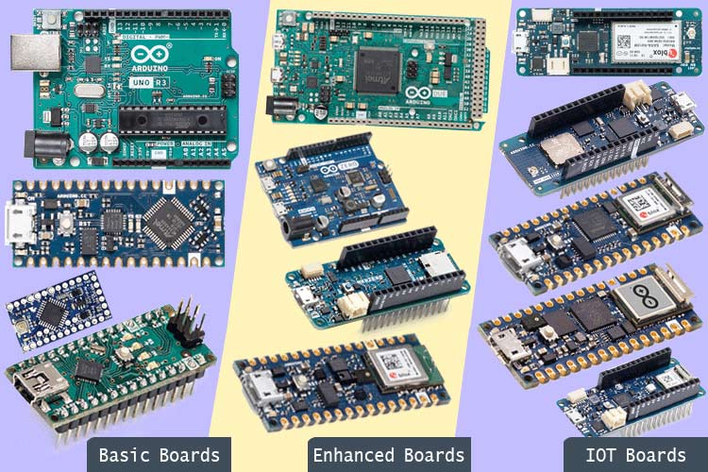
ARDUINO
Arduino UNO is a single board computer. Arduino is an open source physical computing platform based on a simple input/output (I/O) board. The type of the Arduino board used in this paper is ATMega328P Arduino Uno Microcontroller having 2KB static RAM, 32KB flash memory, 8 bit CPU, 6 Analog I/O pins and 14 Digital I/O pins . The language used to program the Arduino microcontroller is C/C++. Programs are created in the Arduino development environment that compiling and linking source code and downloaded to the Arduino board where it start running .

Slide 15
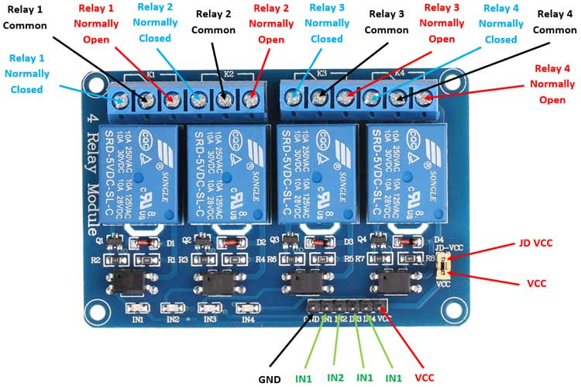
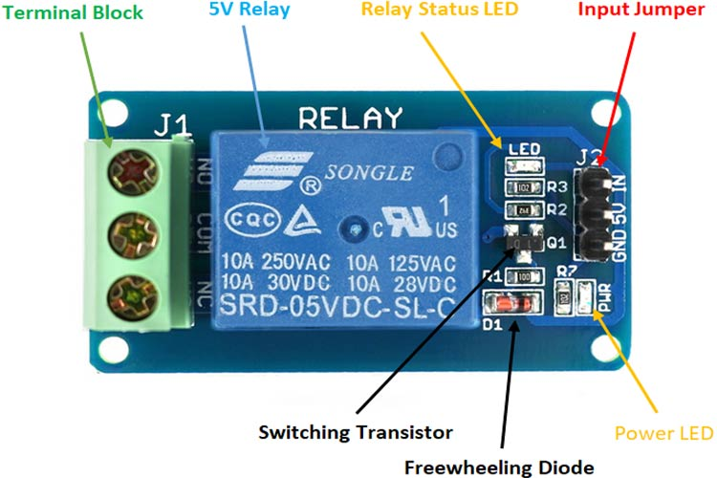
RELAY MODULE
Relay boards are computer boards with an array of relays and switches. They have input and output terminals and are designed to control the voltage supply. Relay boards provide independently programmable, real-time control for each of several onboard relay channels.

Slide 16
MOBILE APPLICATION
Android operating system is primarily designed for smart phones and tablets. Android applications are written in Java programming language using the Android software development kit (SDK) and run in virtual machines . The ATMega328P Microcontroller is connected by HC-05 Bluetooth Module using wireless technique to the Bluetooth Controller Android application, and the Input/output ports of the embedded system board are connected to home appliances. Android is the base of the application software, which has the largest base of Smartphone. The Smartphone screen of Android application is shown

Slide 17
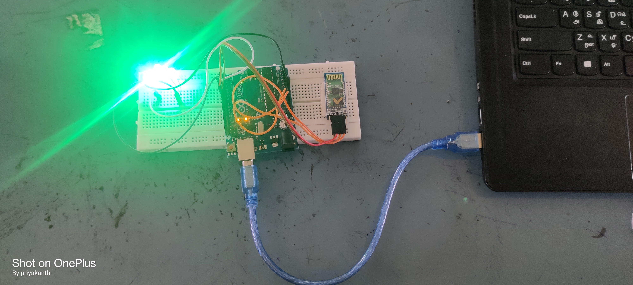
RESULT

Slide 18
REFRENCES
WIKIPEDIA Link :- https://en.wikipedia.org/wiki/Home_automation
Wirelesss Sensor Networks: Concepts, Appli Control, HVAC Control Analysiscations, Experimentation and Analysis.2016.p.ISBN 9811004129
Jump up “ Reaserch and Markets: Global Home Automation and Control Market 2014-2020 – Lighting Control, Security & Access Control Analysis of the $ 5.77 Billion Industry” Routers. 2015-01-19. Archived from the orginal on 2016-05-05.
Home Automation & Wiring (1 ed.). New York: McGraw-Hill/TAB Electronics. 1999-03-31. ISBN 9780070246744.

Slide 19
THANK YOU

